Slide 1
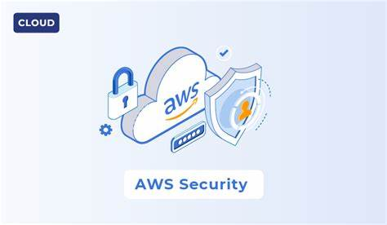
Security Implementation

Slide 2
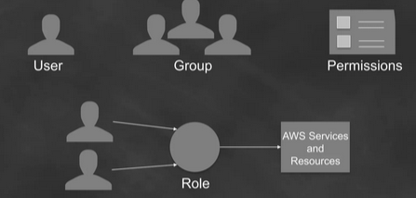
AWS Identity and Access Management (IAM)
• Enables you to control who can do what in your AWS account
• IAM uses access control concepts that you are already familiar with User Group Permissions Role AWS Services and Resources

Slide 3
AWS Identity and Access Management (IAM)
• Control
– Centralized
– Fine-grained - APIs, resources, and AWS Management Console
Security
– Secure (deny) by default
– Multiple users, individual security credentials and permissions

Slide 4
. IAM Users
What
Entity that represents the person or service that uses it to interact with AWS
Consists of a name and unique set of credentials
Console password
Access Key
MFA device (SMS, Virtual, or Hardware)
Each IAM user is associated with one and only one AWS account; does not require a separate payment method.
When
Enable human or programmatic access to AWS resources and services
E.g. New employee, Rob, requires access to Amazon EC2 and Amazon S3 services
E.g. Rob has created an application that stores data in Amazon DynamoDB

Slide 5
IAM Users
Why (Benefits)
Do
Unique set of credentials Individual permissions
Granular control
Easy to revoke access
Create IAM user for yourself
Create individual IAM users for others
Don’t
• Distribute your AWS root credentials
• Use your root account user
• Share your IAM user credentials

Slide 6
IAM Users and Permissions
No permissions by default
Permissions specify who has access to AWS resources, and what actions they can perform on those resources
Assign permissions individually to each user (or use Groups)
Rob (UX Designer) > access to Amazon S3
Samantha (Database Administrator) > access to select Amazon EC2, Amazon RDS, Amazon DynamoDB, AWS Lambda, and AWS Data Pipeline APIs
Use IAM Policies to assign permissions

Slide 7
IAM Policies
JSON-formatted documents
Contain a statement (permissions) which specify:
What actions a principal can perform
Which resources can be accessed
Example of an Amazon S3 Read-Only Access Template { "Statement": [ { "Effect": "Allow", "Action": ["s3:Get*", "s3:List*"], "Resource": "*" } ] } •
Attach policy to a user, group, or role (identity-based permissions) Attach policy to select resources e.g. Amazon S3 buckets (resource-based permissions)
Example of identity-based permission Rob Can Read, Write, List On Resource : icon-designs
Example of resource-based permission icon-designs Rob: Read, Write, List Samantha: List Zoe: Read, List

Slide 8
IAM Policies
. Two types of identity-based policies in IAM
Managed policies (newer way)
Can be attached to multiple users, groups, and roles
AWS managed policies (created and managed by AWS)
Customer managed policies (created and managed by you) o Up to 5K per policy o Up to 5 versions
You can limit who can attach managed policies
Inline policies (the older way)
You create and embed directly in a single user, group, or role
Variable policy size (2K per user, 5K per group, 10K per role)

Slide 9
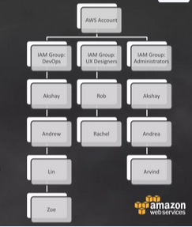
. IAM Groups
What
Example of managing permission using groups
Collection of IAM users
Specify and manage permissions for multiple users, centrally
E.g. group for all UX Designers
A group can contain many users, and a user can belong to multiple groups
When
Easily manage permissions for multiple users

Slide 10
IAM Groups
Why (Benefits)
Do
Reduces the complexity of access management as number of users grow
Easy way to reassign permissions based on change in responsibility
Easy way to update permissions for multiple users
Reduces the opportunity for a user to accidently get excessive access.
Create groups that relate to job functions
Attach policies to groups
Use managed policies to logically manage permissions
Manage group membership to assign permissions

Slide 11
IAM Roles
What
Another identity with permission policies that determine what the identity can and cannot do in AWS
Can be assumed by anyone who needs it; not uniquely associated with one person or application
Does not have credentials; access keys are created and provided dynamically
When
Give cross-account access
Give access within an account
E.g. access for application running on Amazon EC2
[Federation] Give access to identities defined outside AWS
E.g. access for identities maintained in your corporate IdP

Slide 12
Use IAM roles to share access
Why (Benefits)
Do
. No need to share security credentials
No need to store long-term credentials
Control who has access.
Use roles to delegate cross-account access
Use roles to delegate access within an account
Use roles to provide access for federated users

Slide 13
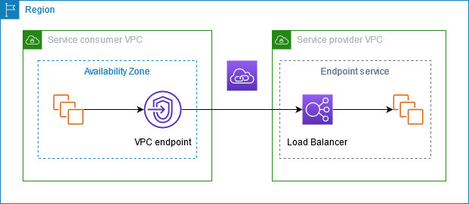
VPC Endpoints
VPC Endpoints offer a highly secure and efficient method for connecting your AWS resources to specific AWS services, ensuring that your data remains within the AWS network, and minimizing exposure to the public internet.

Slide 14
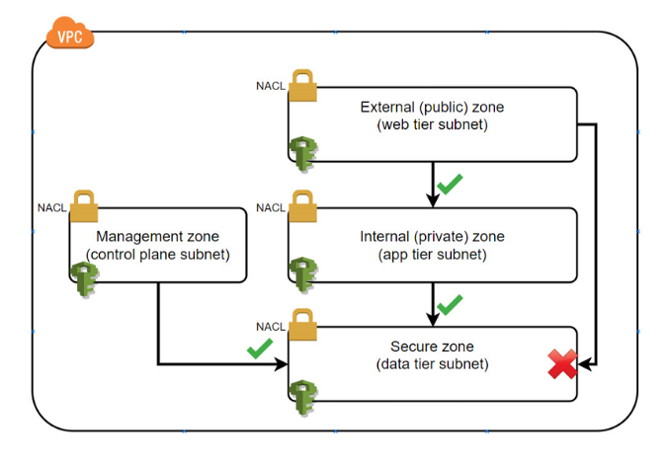
Data Encryption at Rest and in Transit

Slide 15
Encryption for data at rest
File-level encryption: Encrypts individual files.
Storage-level encryption: Encrypts entire storage devices.
Database encryption: Used for encrypting structured data.
Data tokenization: Replaces sensitive data with opaque tokens.
Cloud storage encryption: Offered by cloud service providers to encrypt data on a per-file or per-bucket basis.

Slide 16
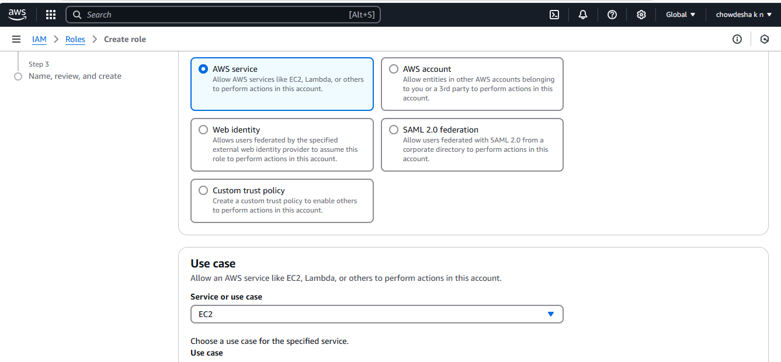
Navigate to IAM, then click on role and select use case as ec2 then click on next

Slide 17
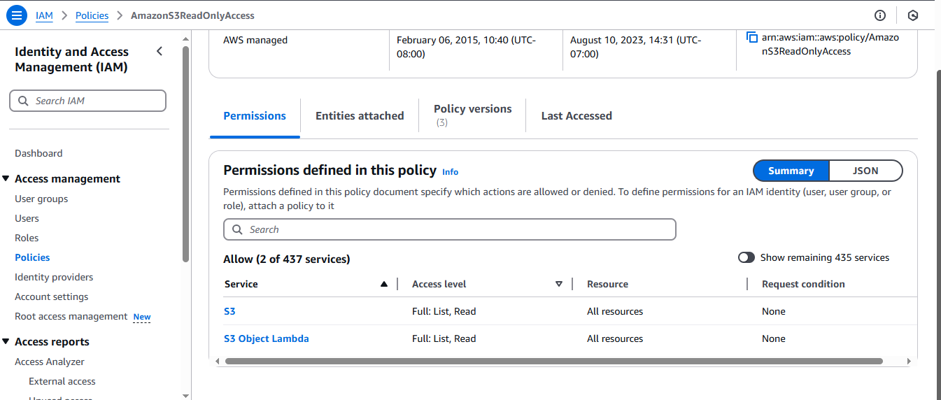
Navigate to attach policy select amazons3fullaccess then click on next

Slide 18
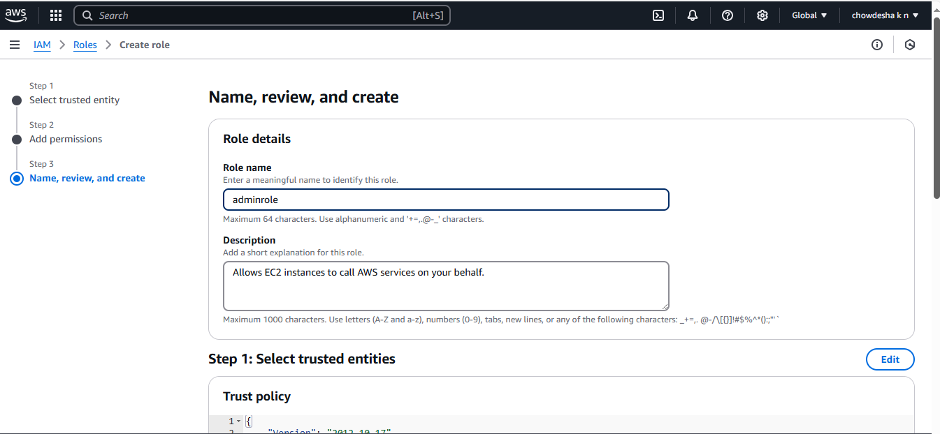
Provide role name and review all details and create

Slide 19
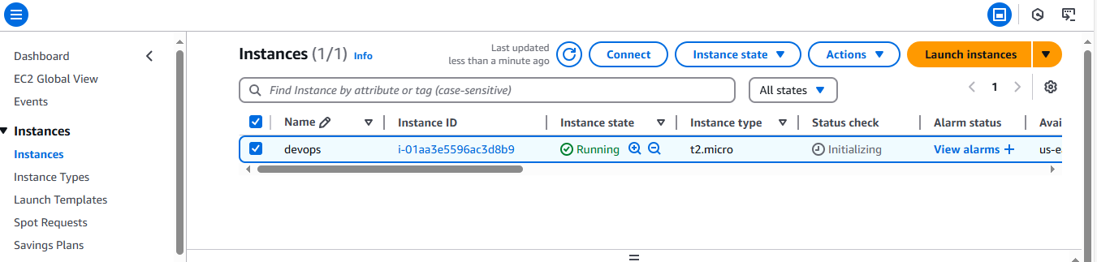
Create instance then select instance, then click on action change security group

Slide 20
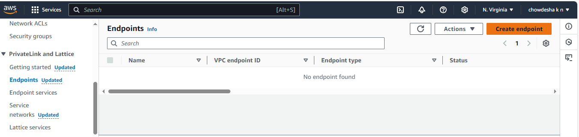
Navigate to vpc then select endpoints

Slide 21
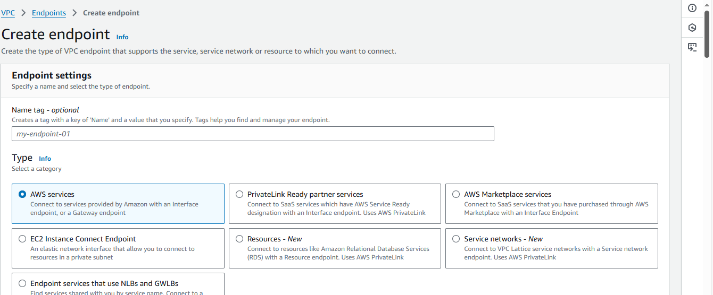
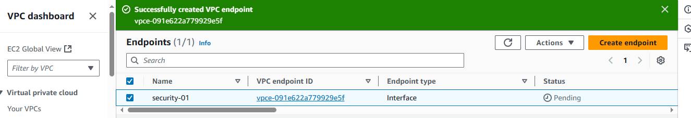
Click on create end point, then select vpc subnet and provide name

Slide 22
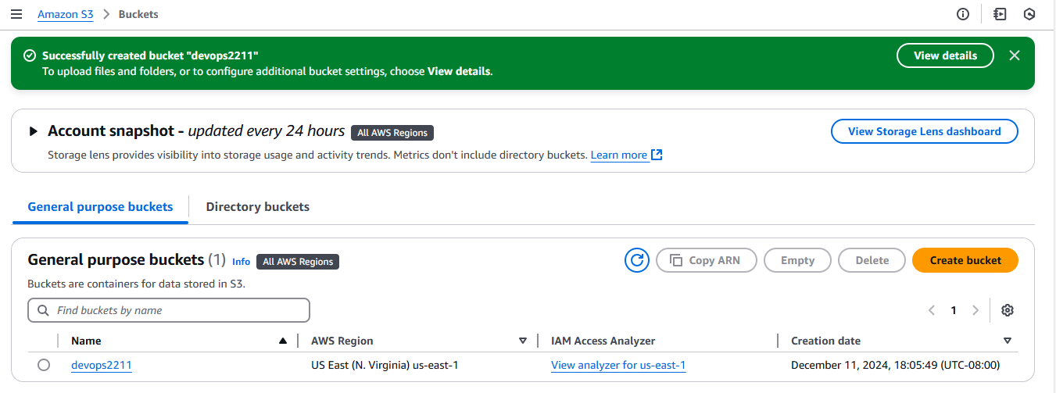
Navigate to s3, create new bucket provide name as devops2211

Slide 23
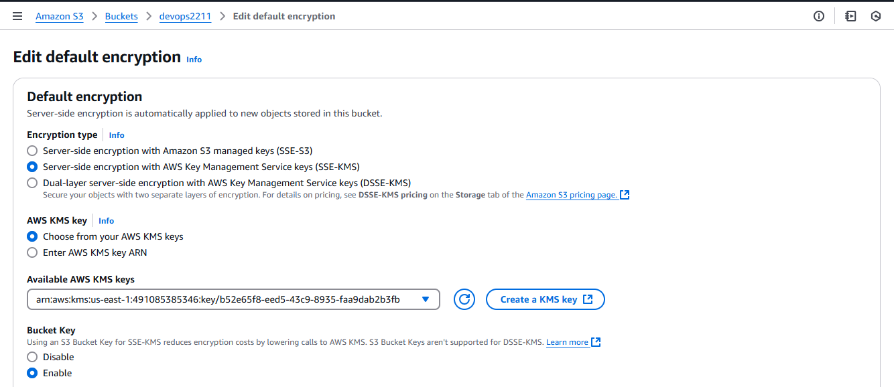
Navigate to created bucket, select properties, in edit default encryption select SSE-KMS

Slide 24
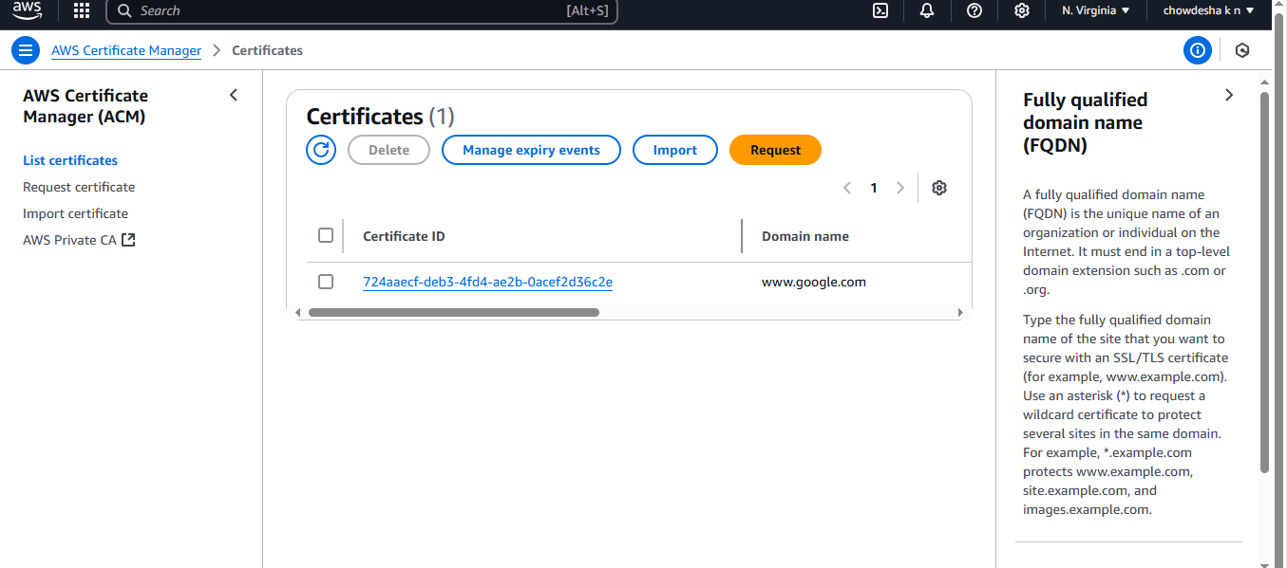
Navigate to ACM console, then click on request a certificate then validate domain ownership once certificate issued, click on action and export, then choose the certificate format then export

Slide 25


